Slide 1

Fast Break Analytics
End-to-End NBA Data Pipeline & Analytics Project
Dataexpert Data Engineering Bootcamp Capstone Project
By: Olumuyiwa Donaldson Ajilore

Slide 2
About Me
I am a 4th Year Computer Science undergraduate student at Laurentian University, Greater Sudbury, Ontario, Canada.
My LinkedIn: www.linkedin.com/in/olumuyiwa-ajilore
My GitHub: www.github.com/Sirdonaldo
My Email: donaldsonajilore@gmail.com

Slide 3
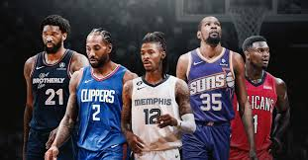
Problem Statement
NBA data is massive, scattered, and messy
Raw event streams + static player info are hard to join/analyze directly
Analysts and fans need a single source of truth for insights in real-time

Slide 4
Data Sources
BallDontLie API -> Player data (CSV)
Confluent Kafka (Cloud) -> Live NBA event stream (JSON)
Combined data exceeds 1M+ rows

Slide 5
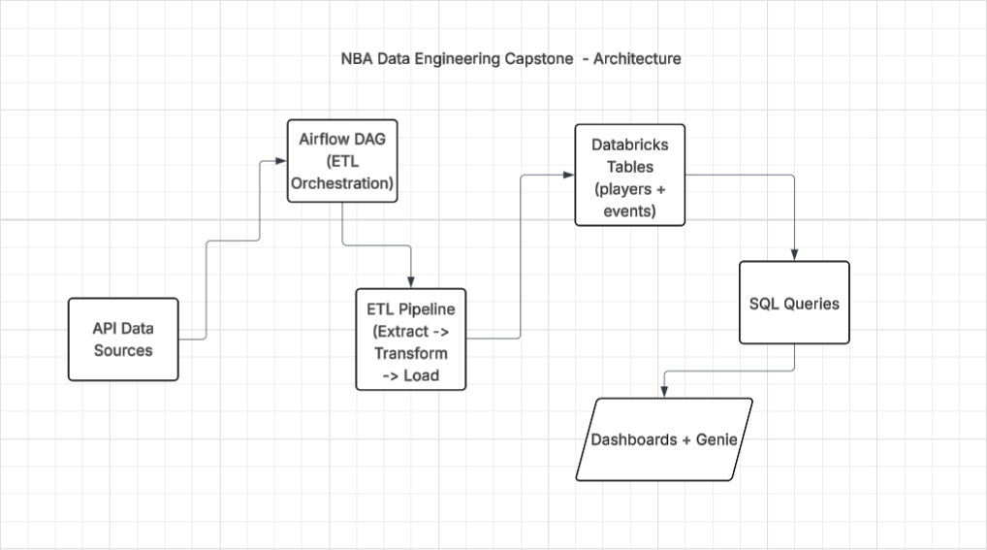
Architecture

Slide 6

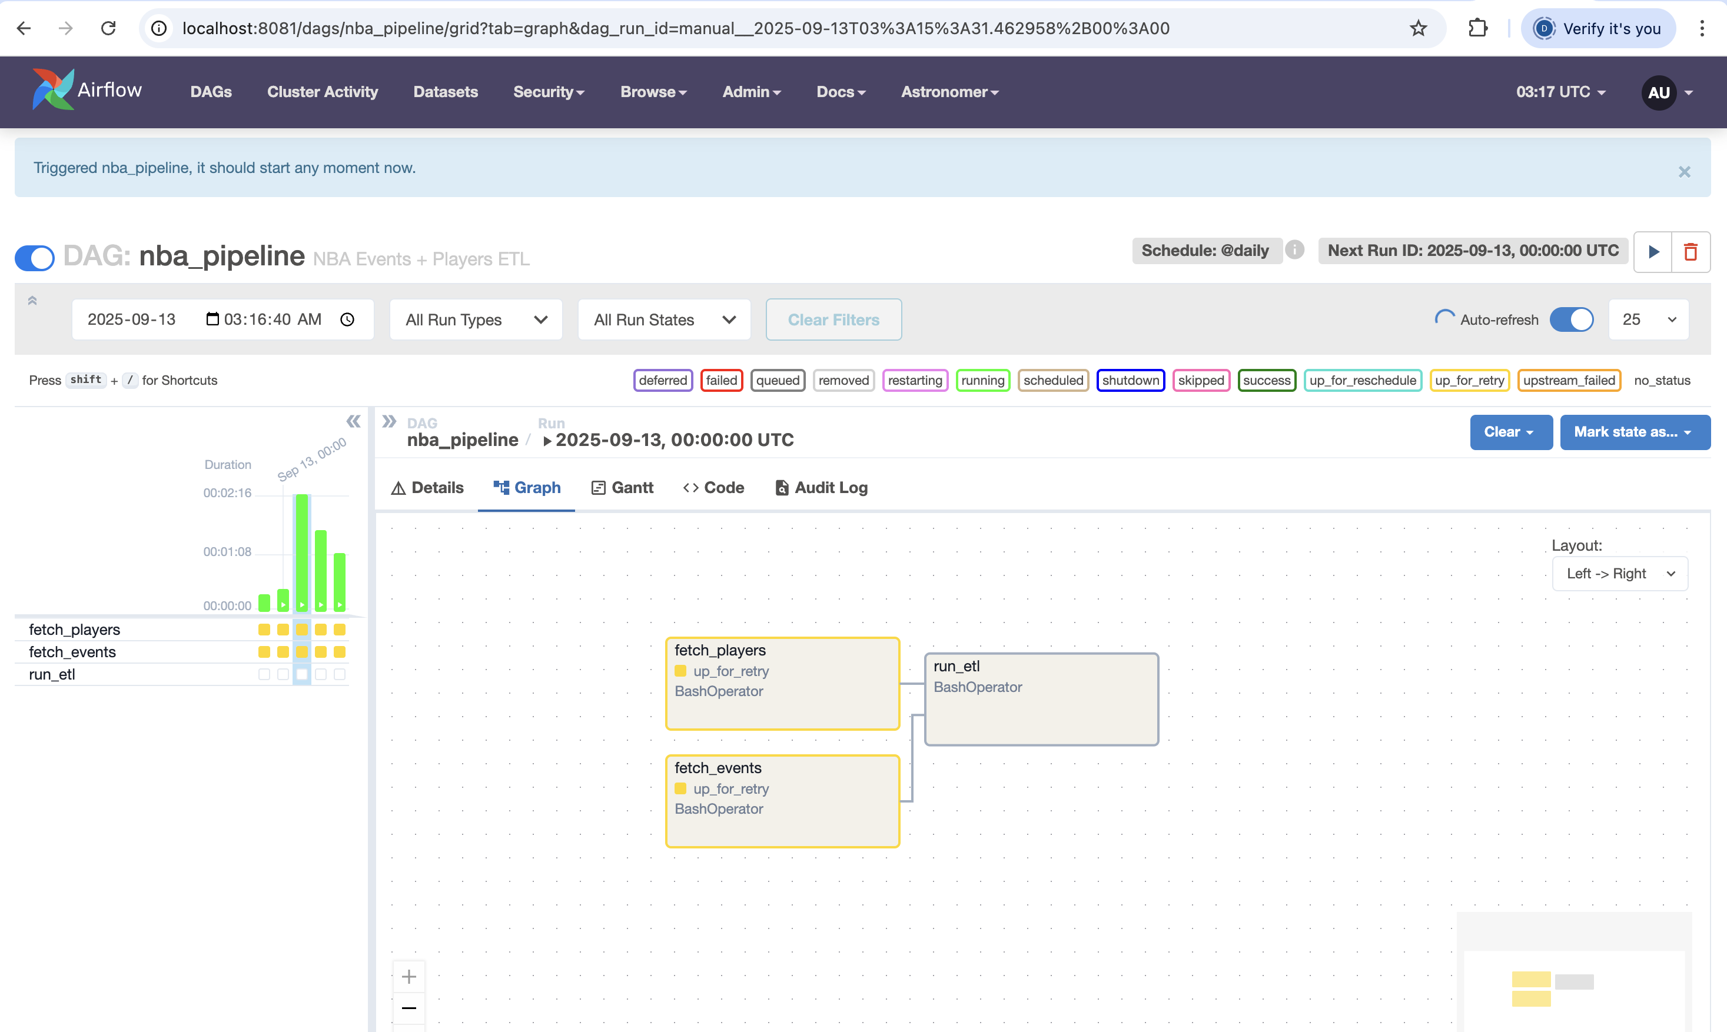
DAGs (Workflow Orchestration)
Built with Apache Airflow (Astronomer)
Ensures repeatable & reliable daily workflows
Automates:
Player ingestion (BallDontLie -> CSV)
Event ingestion (Kafka -> JSON)
ETL jobs for cleaning + joining

Slide 7
Pipeline Workflow
Ingestion: Fetch players + stream events
Transformation: Clean schema, join data
Orchestration: Automated daily DAG in Astronomer
Storage: Persisted in Unity Catalog (Databricks)
Analytics: SQL queries for KPIs
Visualization: Dashboards + Genie

Slide 8
Data Schema
Players Table: id, name, position, country, college, draft info
Events Table: team, player, action, outcome, timestamp
Join on player names to enrich event stream

Slide 9
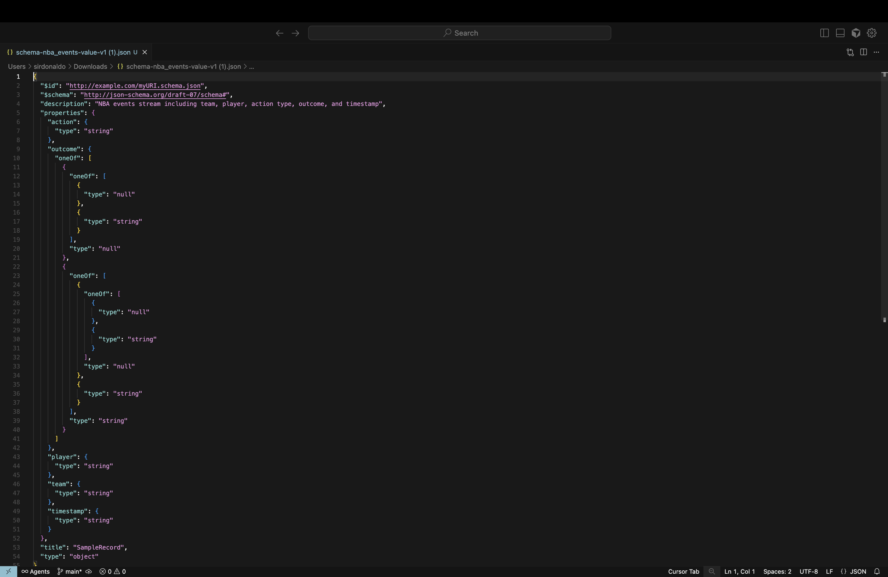

Slide 10
Key Performance Indicators (KPIs) and Queries
Total Events Count
Top 3-Point Attempts
3-Point Shooting Efficiency
Top Steals
Top 10 Blocks
Players by Country etc.

Slide 11
Dashboards
KPI Cards: Event count, player count
Charts: 3PT attempts, efficiency, steals, blocks, rebounds, country breakdown
Demo (in Databricks)

Slide 12
Genie Demo
Ask data questions in natural language:
“Who has the most 3-point attempts?”
“Which team has the best shooting efficiency?”
“How many players are from Canada?”

Slide 13



Technologies Used
Python/Pandas: data validation, schema checks
BallDontLie API: player dataset
Confluent Kafka(Cloud): streaming events
Apache Airflow(Astronomer): orchestration
Apache Spark/Databricks: ETL + SQL
Databricks Dashboards: visualization
Databricks Genie: conversational analytics

Slide 14
Key Learnings
Building reproducible ETL workflows with Airflow
Managing streaming + batch data sources
Handling schema alignment between CSV + JSON
Persisting and querying data with Databricks
Delivering insights via dashboards and conversational AI

Slide 15
Future Work
Add real-time dashboard refresh (not just batch
Enrich events with play-by-play stats (rebounds, turnovers, fouls)
Deploy pipelines with CI/CD (GitHub Actions)
Integrate ML model for player performance predictions
Optimize costs by tuning Kafka + storage retention

Slide 16
Conclusion
Built an end-to-end NBA insights data pipeline
Solved the problem of messy, scattered data
Delivered actionable insights at scale
Ready for real-world application

